Slide 1

The app that helps you reach your peak in fitness and health!
FitTrack
25A10357
Daniel Jerbi
207856295

Slide 2



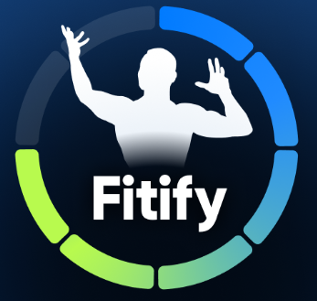

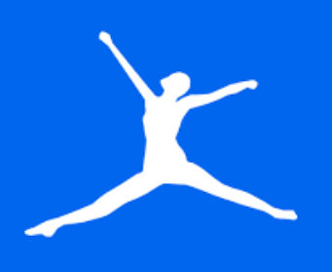

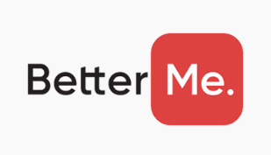

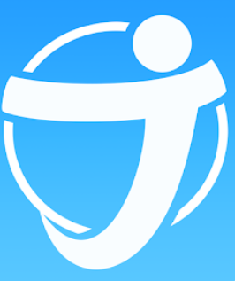

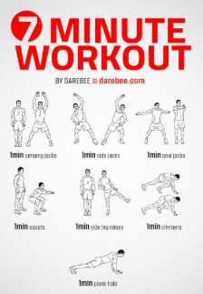
Market Research
There are more than 15 similar applications
Search keywords:
Fitness app
Workout tracker
Motivation for fitness
Personalized workout plans

Slide 3
App Features
Progress Tracking:
Graphs for tracking calories burned.
List of completed workouts with date and time.
Option to add a new workout.
Profile Management:
View user details (name, weight, age).
Edit profile information.
App Navigation:
Buttons for navigating between Home, Workout Plans, Progress, and Profile screens.
Responsive Design:
User-friendly layout with consistent button sizes and spacing.
Splash Screen:
App logo display with a short delay before proceeding to the login screen.
User Authentication:
Login via email and password.
Login via phone number.
Login using a Google account.
Account creation for new users.
Personalized Greetings:
Display a welcome message with the user’s name.
Workout Plans:
Search functionality to find workout plans.
Display categorized workout plans (e.g., Cardio, Strength, Flexibility) with descriptions and images.

Slide 4
FitTrack - wireframes
1. Splash Screen:
Displays the app’s logo (heart with a dumbbell) centered.
Simple design with a clean background.
Short delay before transitioning to the next screen.
2. Login Screen:
Login options:
Email and password.
Phone number.
Google account.
"Create New Account" button for new users.
Simple input fields and clear buttons.
3. Home Screen:
Welcome message: "Welcome, [Username].“
Three navigation buttons:
Workout Plans.
Progress.
Profile.

Slide 5
FitTrack - wireframes
4. Workout Plans Screen:
Search bar at the top.
Three cards:
Cardio (with image and short description).
Strength (with image and short description).
Flexibility (with image and short description).
A "More Plans" button at the bottom.
5. Progress Screen:
Bar chart displaying progress (e.g., calories burned).
List of completed workouts with:
Name of the workout.
Date and time.
"+ Add Workout" button at the bottom.
.
6. Profile Screen:
Circular profile picture placeholder.
Fields to display user details:
Name.
Weight.
Age.
"Edit Profile" button below the details.

Slide 6
The server's uses
use that will be made on the server:
Backup and transfer data between users with firebase Real-time Database.
Backup and transfer data between users with firebase FireStore.
Firebase Authentication to manage users.
Firebase Cloud Storage.

